Slide 1
Analyzing Sales Methods to Maximize Revenue
By Nicholas Tawil
Notes:
Hello, I am Nick Tawil. Today we will be analyzing sales methods in order to maximize revenue.

Slide 2
Presentation Topics
Who are our customers?
How do we sell to them?
How effective is each sales method?
How do we leverage our best sales methods to maximize revenue?
Notes:
To demonstrate, we will walk through the following topics

Slide 3
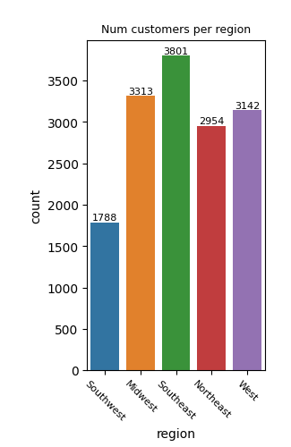
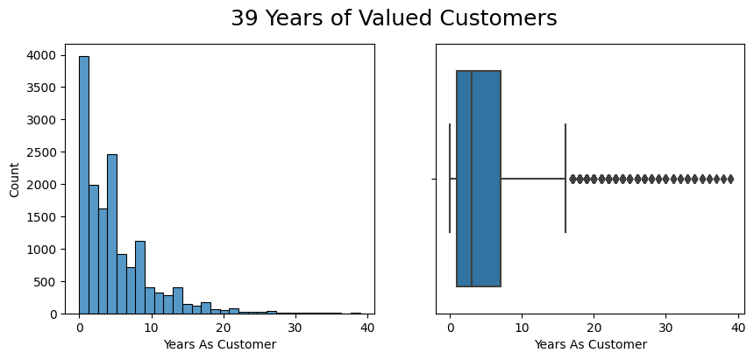
Defining our Customers
Recent customer acquisition
Diverse throughout the US
Notes:
Out of almost 15,000 unique Pens and Printers customers, the majority of them are new to us (within 1-8 years). This shows recent growth as a company. Additionally, customers are spread throughout the 5 notable regions of the United States. As you can see the Southwest would be wise to target with promotions and deals. There is more opportunity for growth than in the Southeast, where we already have a strong presence.

Slide 4
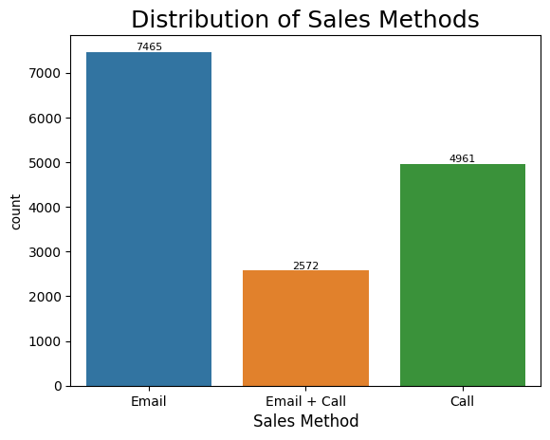
Sales Methods
3 sales Methods
Email
Email + Call
Call
67% of sales used email in some capacity, with 49% using only email
Notes:
How do we reach these customers? We collected data over the first 6 weeks of our new product launch, in order to understand what we are trying and how we are performing. We reached out in 3 different ways (email, an email followed by a call from our sales team, and simply a phone call). *read last bullet* Now how did these methods perform?

Slide 5
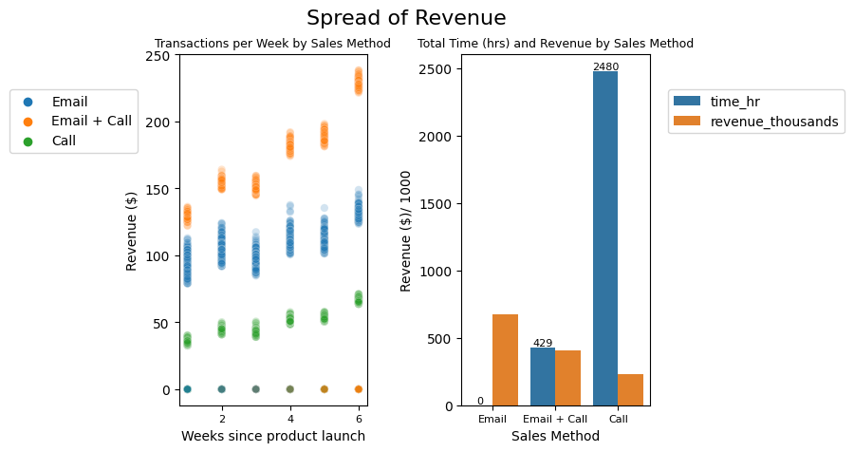
Sales Method Performance
Email
Generates the most total revenue
No effort required from Sales team
2480 hours for least effective revenue stream
Notes:
Email generated the most total revenue, with Email and Call next, followed by Calling in third. It is also significant to point out that sending an email can be automated, and thus has been designated a negligible 0 hours of effort on behalf of the sales team. Given that 67% of our sales involve email to some extent, it is unfortunate how much time is spent on calls to generate such low revenue. Given an estimated 30 minutes per sales call, the sales team spent just under 2500 hours cold calling customers. But still, one third of all sales are made over the phone, how is call revenue so low?

Slide 6
Sales Method Performance
Average Revenue per Sales Method transaction:
Email → $90.00
Email + Call → $158.70
Call → $45.90
Email generated the most unique customer sales and total revenue, but Email + Call is the most effective per transaction
Calling is ineffective and time consuming
Notes:
On the right you can see every transaction, colored by sales method and separated by weeks since product launch. As you can see, calling is consistently underperforming email, which is in turn underperforming the email and follow up call sales method. Interestingly, all 3 sales methods generate more revenue per transaction as the weeks go by. We know that *read second point*, from $90 to $158. Whereas calling remains underperforming at only $45 per transaction, making up for the least amount of revenue. How much revenue is lost on calling customers without first sending them an email?

Slide 7
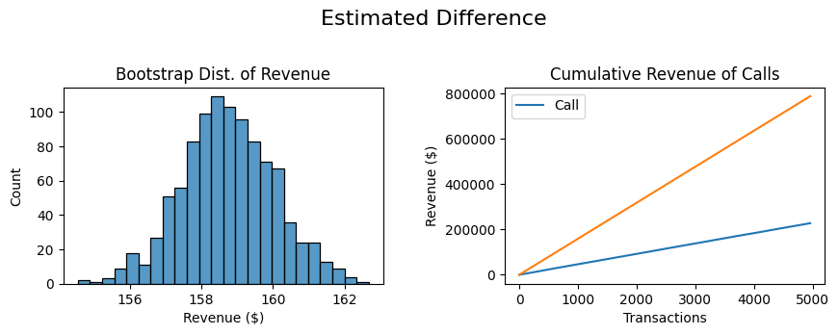

Don’t Call Me
What if every phone sale was led with a marketing email?
Simulate Email + Call performance on Call transactions
Randomly selected Email + Call Transactions and recorded their revenue
Record the mean
Repeat 1000 times
Projected Revenue per transaction = mean of 1000 means
$158.70
What_If ~$600,000 missed revenue
157 | 159 | …
150 | 154 | …
156 | 158 | …
154 | 170 | …
149 | 150 | …
148 | 130 | …
… | … | …
Notes:
Lets imagine every phone sale was led with an email. First, we need to establish the Email + Call performance and simulate it on the amount of transactions strictly cold Calling customers. I randomly selected a group of transactions which used the Email+Call sales method, recording every revenue and taking the mean of that group. I repeated this process 1000 times until I had 1000 means, which I plotted in Step 3. The mean of these 1000 means is what I am defining as the Projected Revenue per transaction. This value can be used to anticipate future transactions using Email+Call sales method, provided a similar customer base. Using this value, I plotted the cumulative revenue from direct sales calls, along with the the projected cumulative revenue if every one of those sales calls were made after an email was sent. The result is an estimated 600,000 dollars in lost revenue, not to mention the hours spent on calls. Previously, calls took 30 minutes per customer, whereas this method only takes 10 minutes.

Slide 8
In Summary
Emailing customers reached the most customers and generated the most total revenue
Following up an email with a phone call increases the average transaction for that customer by 76% ($90 to $158)
Calling customers without an email is time consuming and the least efficient sales method
We can continue to track Average Revenue per Transaction to identify which sales method is the best performer for future product launches
Thank you
Notes:
Emailing customers reached the most customers and generated the most total revenue
Following up an email with a phone call increases the average transaction for that customer by 76% ($90 to $158)
Calling customers without an email is time consuming and the least efficient sales method
We can continue to track Average Revenue per Transaction to identify which sales method is the best performer for future product launches
Thank you

